Slide 1

Trade relation between Alberta and Nepal:

Slide 2
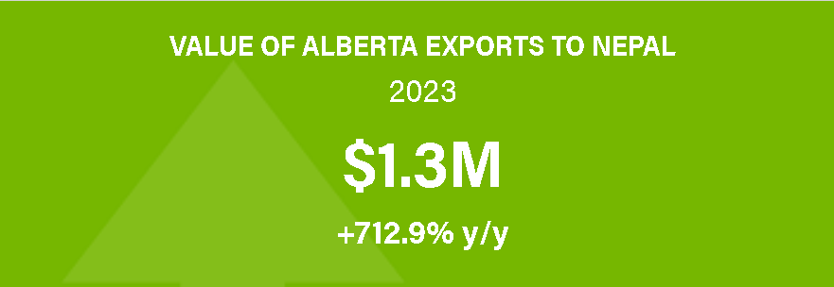
Evidence of trade relation between Nepal and Alberta.
In 2020, Alberta exported over $17.2M worth of products to Nepal. (Alberta, 2023)
Nepal is considered as 60th ranked country for Alberta’s exports. (Alberta, 2023)
Canada exported more than $105.8 million, in year 2018. (Canada, 2018)

Slide 3
Macroeconomic factors for growth by trade with Nepal.
Increased Trade balance
Economic growth
International influence
Industry development.

Slide 4
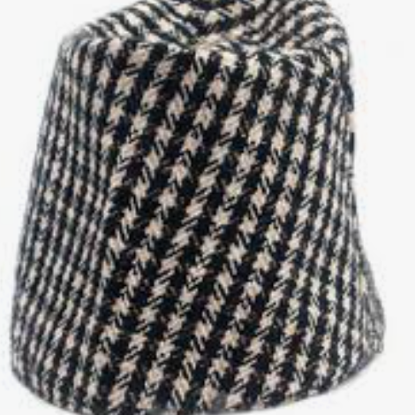
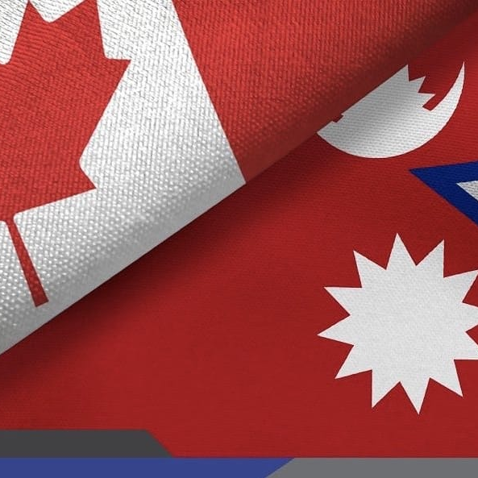
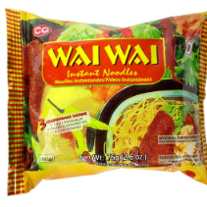
Nepali Market in Alberta:
Wholesale Nepali Lokta Paper in Alberta Canada
Binoo Minimart Authentic Nepali Grocery Store
Yak and Yeti Retail and Wholesale

Slide 5
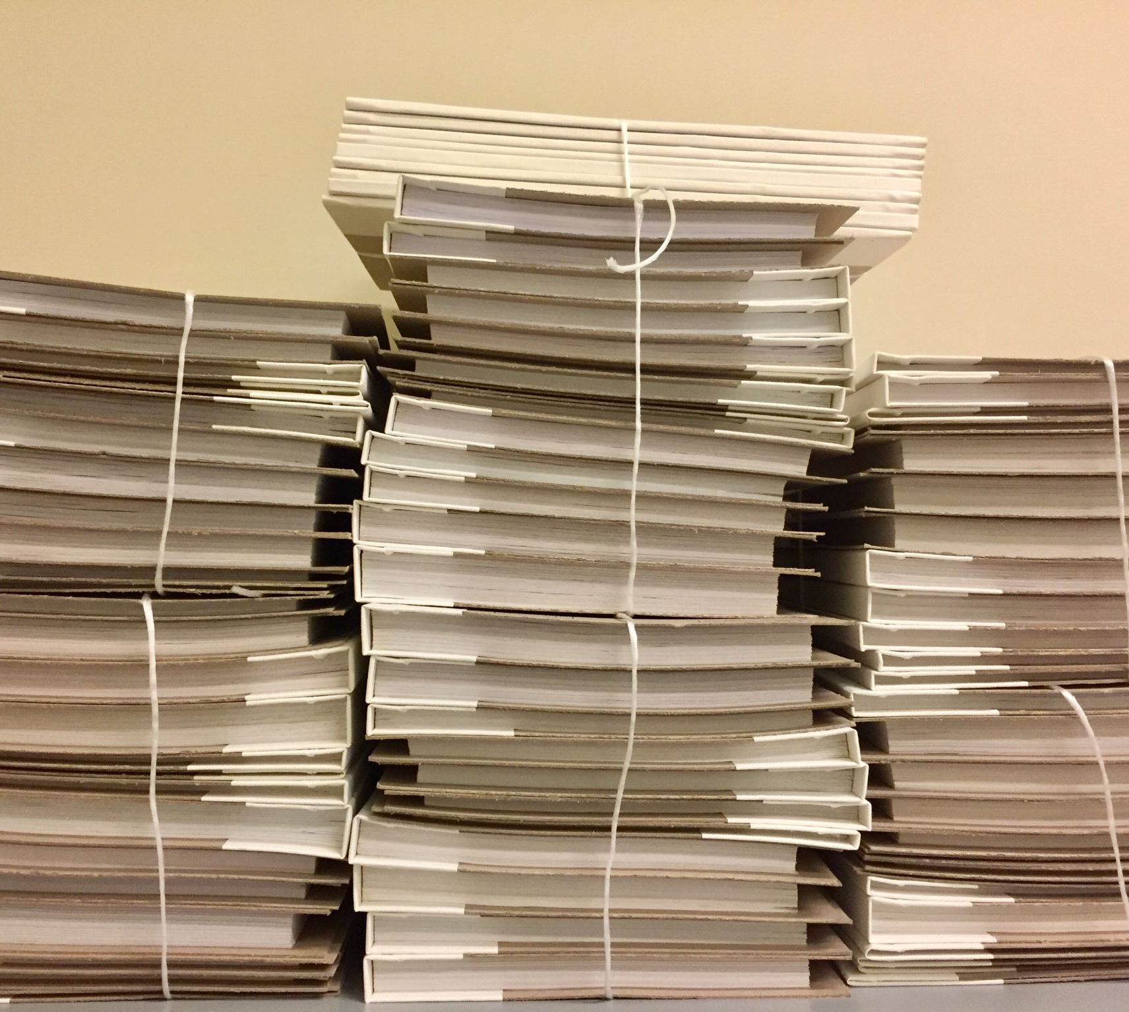
Wholesale Nepali Lokta paper in Alberta Canada
Lokta paper is Nepali homemade paper which is made up of Lokta plant.
This Nepali wholesale shop is selling lokta paper in bulk in Canada. (Ltd., 2024)

Slide 6

Yak and Yeti Retail and Wholesale
Yak and Yeti Retail and Wholesale shop is one of the popular grocery shop in Calgary, Canada.
Shop sells almost every Nepali grocery products in Canada, like tea, oil, noodles and so on.

Slide 7
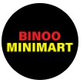
Binoo Minimart Authentic Nepali Grocery Store
Binoo Minimart Authentic Nepali Grocery Store is a grocery store that sells authentic Nepali grocery items.

Slide 8
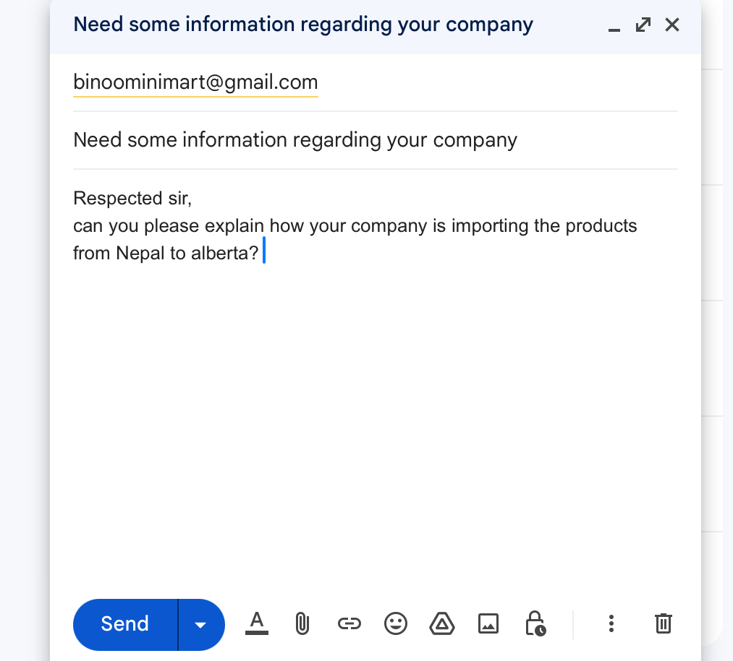

Slide 9
Refrences
Alberta. (2023). Alberta Exports To Nepal. Retrieved from Alberta: https://export.alberta.ca/market-profiles/nepal/
Canada, G. O. (2018). Canada-Nepal relations. Retrieved from Government Of Canada: https://www.international.gc.ca/country-pays/nepal/relations.aspx?lang=eng
Ltd., P. F. (2024). Wholesale Nepali Lokta Paper in Alberta, Canada. Retrieved from Prime Felt & Agro Industries Pvt. Ltd.: https://www.pfa.com.np/wholesale/local-supplier/32/602/nepali-lokta-paper-in-alberta-canada

